Slide 1

Northwestern State University
General Purchasing
Forms
Purchasing Department:
Ashlee Grayson, Director of Purchasing
Akilah Farris, Purchasing Agent
LaShonda Burton, Purchasing Administrative Coordinator

Slide 2
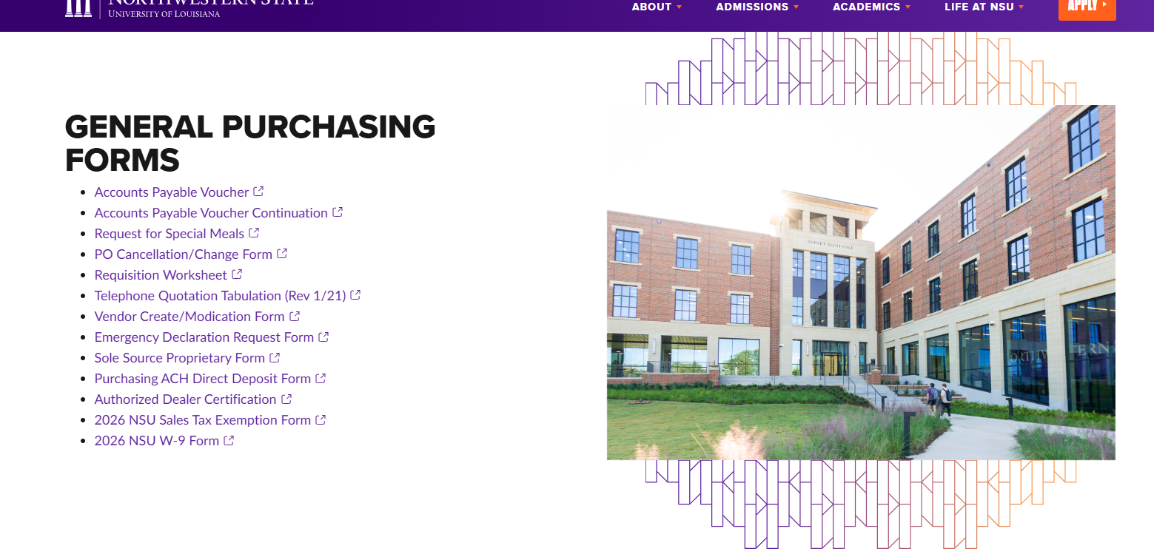
Purchasing Website
https://www.nsula.edu/about/executive-offices/office-of-business-affairs/purchasing/

Slide 3
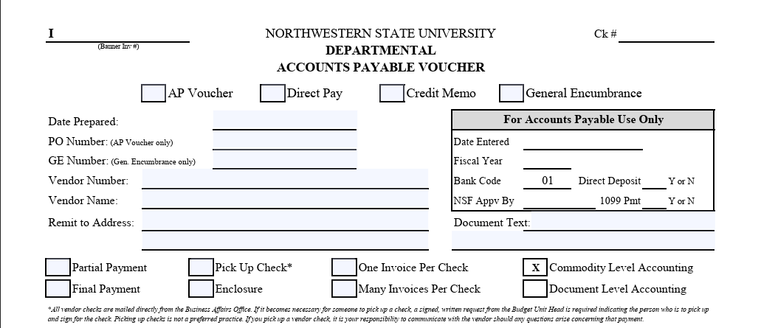
Accounts Payable Voucher
Top Section of Form
Select the box below if completing an AP Voucher
Date you are completing the form
PO # that Form is to be against
Banner Vendor ID #
Vendor Name (must match name on PO)
Where does the check need to be mailed to?
Select whether the payment is Partial Payment or Final Payment

Slide 4
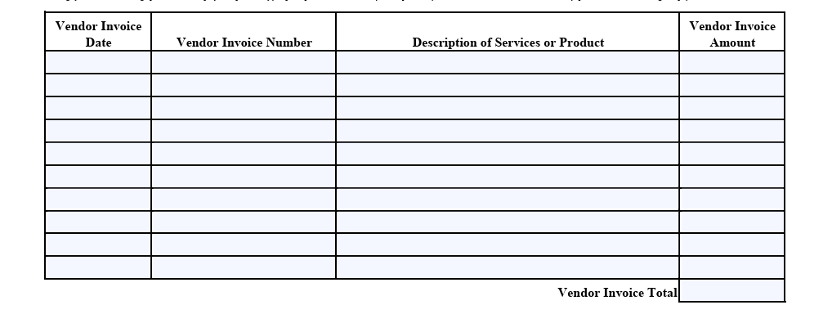
Accounts Payable Voucher
Middle Section of Form.
Enter Vendor Invoice Date
Enter the Invoice Number
What items are listed on the invoice?
Enter the total Invoice Amount
Enter the total Invoice Amount

Slide 5
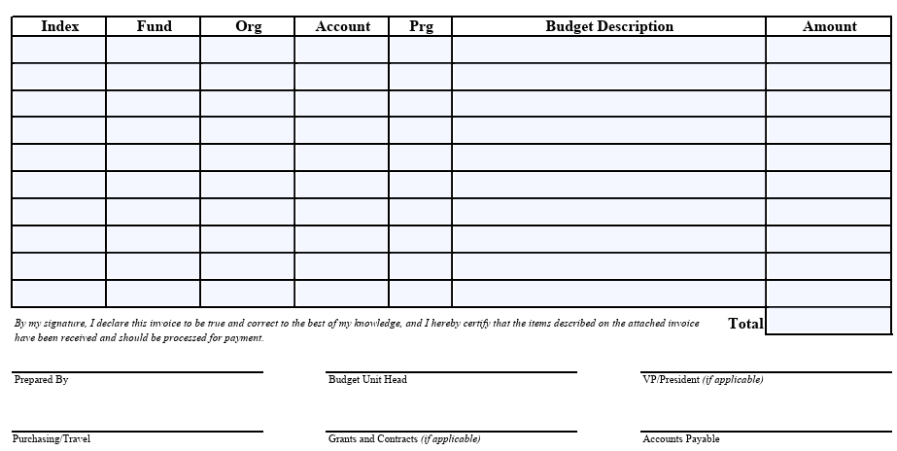
Accounts Payable Voucher
Bottom Section of Form (FOAPAL).
Budget Unit Index #
Account Code (704010 not 704000)
Name of Budget
Total amount that is being charged to that Index and Account Code
Name of Individual who Prepared the form.
BUH that is over the Index listed above.
VP does not need to sign since there is a PO.

Slide 6
Direct Pay Form
Top Section of Form
Direct Pay is only for purchases under $500.00.
Select the box below if completing a DP.
Date you are completing the form
Banner Vendor ID #
Vendor Name
Where does the check need to be mailed to?
Must enter the reason for the purchase.

Slide 7
Direct Pay Form
Middle Section of Form.
Enter Vendor Invoice Date
Enter the Invoice Number
What items are listed on the invoice?
Enter the total Invoice Amount
Enter the total Invoice Amount

Slide 8
Direct Pay Form
Bottom Section of Form (FOAPAL).
Budget Unit Index #
Account Code (704010 not 704000)
Name of Budget
Total amount that is being charged to that Index and Account Code.
Name of Individual who Prepared the form.
BUH that is over the Index listed above.
VP who is the Approving Agent of the Index listed above.
VP must sign since there is not a Banner requisition.

Slide 9
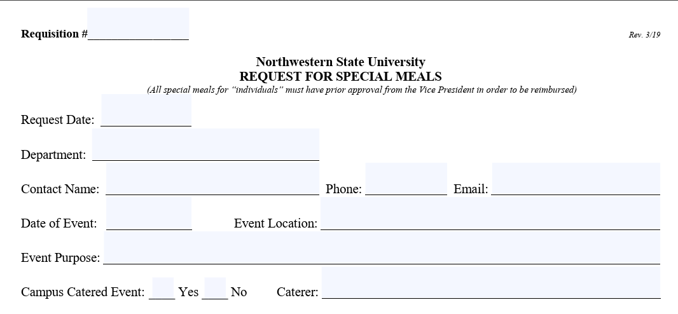
Request for Special Meals Form (SMF)
Must be completed, signed, and submitted to Purchasing Department prior to event taking place.
Must submit form, list of attendees, and quote/invoice to purchasing@nsula.edu.
APV must be submitted to Accounts Payable only after the PO has been processed and the event has taken place.
Top Section of Form
Banner Requisition #
Date of Request
Requesting Department
Department Contact Person
Office #
Contact Person Email
Event Date
Where will the event take place?
What is the purpose for the event? State does not allow parties, socials, etc.
If event is on campus, it must be catered by Sodexo.
Will the event need to be catered?

Slide 10
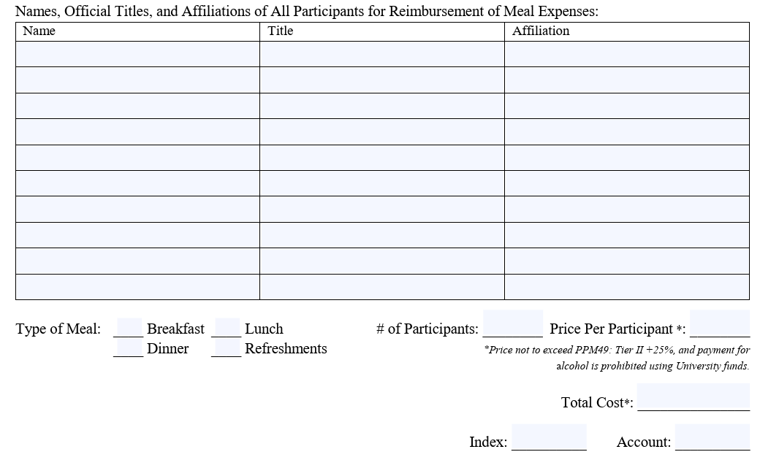
Request for Special Meals Form (SMF)
Middle Section of Form.
Name of Attendees
Their Title
Their Affiliation-
NSU Employee or Student or off-campus vendor
Enter the # of total participants and the price per person
GSA Rate
Select which type of meal it is. Must be within the allowable GSA rates.
Total Cost of Meal
Be sure to enter the Index # and Account Code: 704211

Slide 11
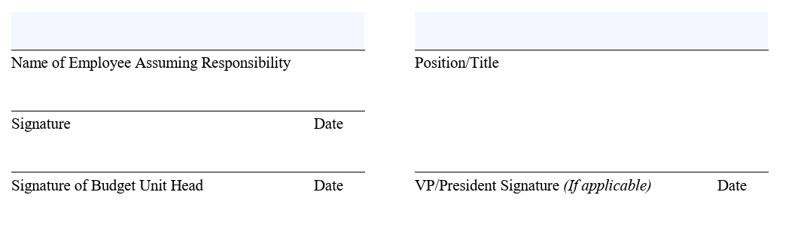
Request for Special Meals Form (SMF)
Bottom Section of Form.
Name of Employee
Their Position/Title
Employee Signature
BUH Signature
VP/President Signature

Slide 12
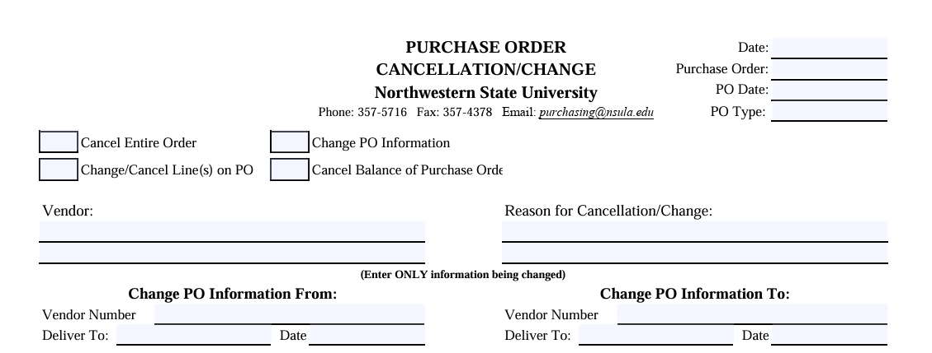
PO Cancellation/Change Form
Top Section of Form
Date Completing the Form
PO #
Select which option the dept is wishing to make a change or cancellation to PO.
Date of PO
What PO Type is it?
Enter the Vendor’s Name
State why dept is requesting the change or cancellation to be made.
If needing to update Vendor Name, dept must enter the current information listed on the PO in this section.
Dept will enter the up-to-date Vendor information in this section.

Slide 13
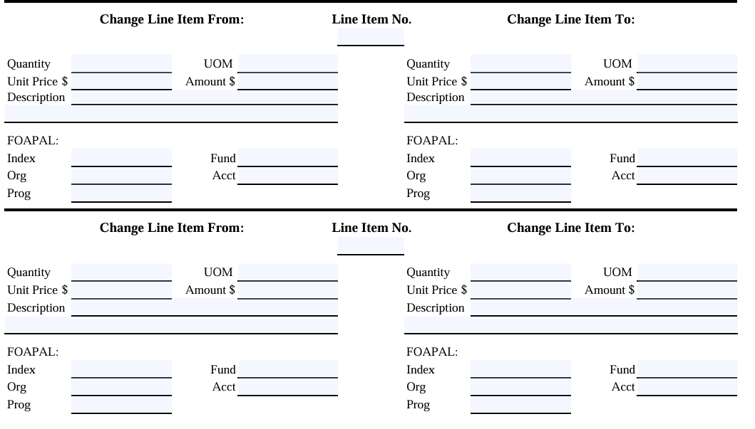
Left Hand Column is information that is currently listed on the PO.
Right Hand Column is information that needs to be changed.
Enter the Line that is needing to be updated.
Be sure to complete EACH section regardless if there is not a change.
Be sure to complete EACH section regardless if there is not a change.
Middle Section of Form.

Slide 14
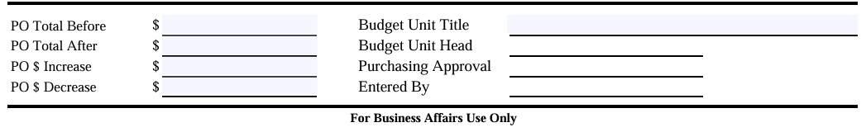
PO Cancellation/Change Form
Bottom Section of Form.
BUH must sign before Purchasing can process the Change Order.
Must enter the PO total before the Change.
Must enter the PO total after the Change (regardless if there is a change or not).
Must enter how much the PO total increased by (if none, then enter $0).
Must enter how much the PO total decreased by (If none, then enter $0).
If PO total is increased, department must check budget prior to submitting the Change Order.

Slide 15
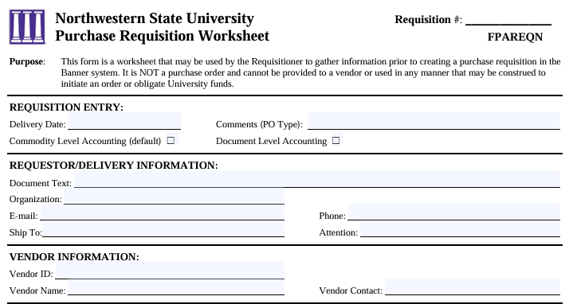
Requisition Worksheet
Top Section of Form.
Typically used during Fiscal Year End/New Fiscal Year.
Be sure to state what type of PO this will be.
Enter Quote Number/Invoice Number etc.
Budget Unit Title
Requestor’s Email
Requestor’s Phone #
Central Receiving or Department’s Physical address
Vendor #
Vendor Name
Contact Person/Sales Rep

Slide 16
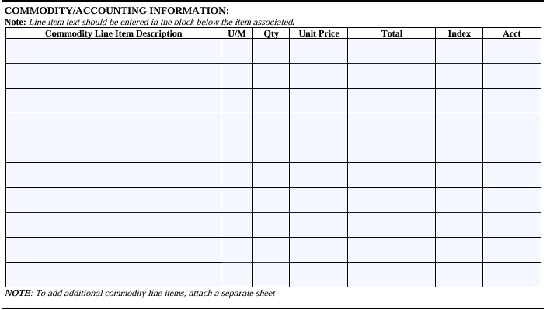
Requisition Worksheet
Middle Section of Form.
Departments must check budget prior to submitting Requisition Worksheet.
List information just as it is listed on Quote or Invoice per line item.
Unit of Measure
# of items
Unit Price per Item.
Total Cost of Line Item 1.
Must fill in Index and Account Field.
Be sure to enter the specific account code (704010) not the account pool (704000).

Slide 17
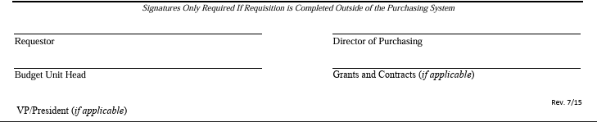
Requisition Worksheet
Bottom Section of Form.
Requestor’s Signature
BUH Signature
VP/President Signature
Once all appropriate signatures have been obtained, please forward this form to purchasing@nsula.edu for processing.

Slide 18
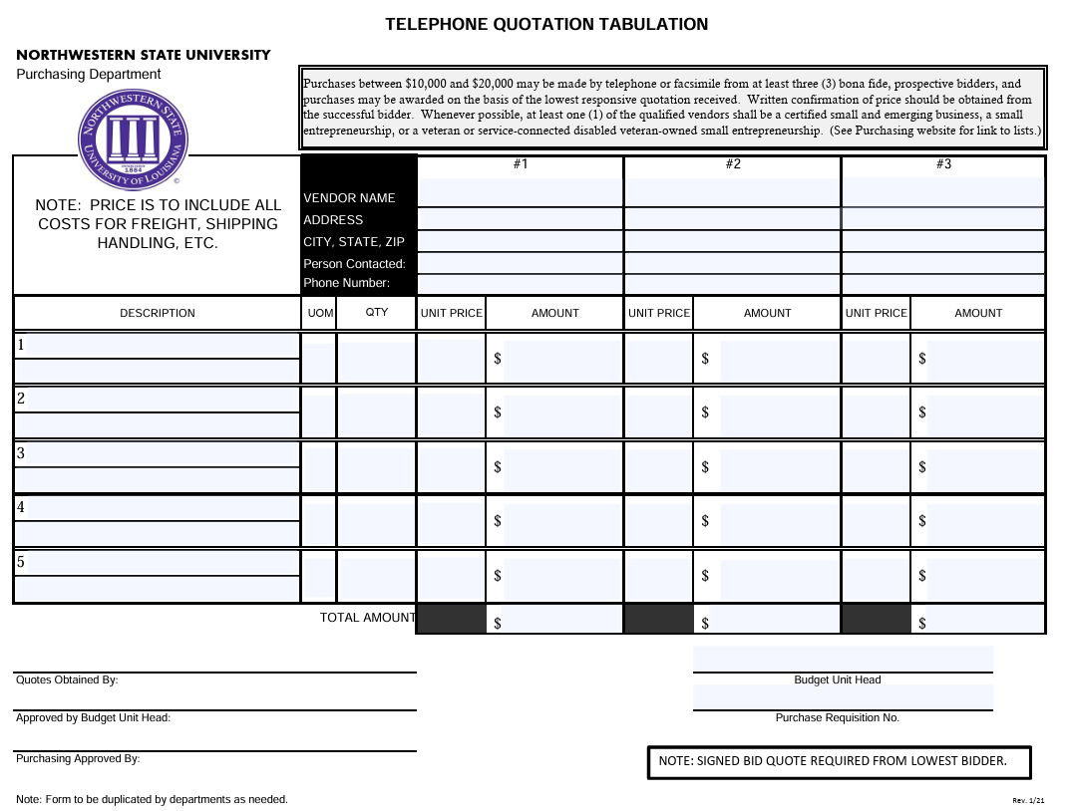
Telephone Quotation Tabulation
Once form is completed and signed and a requisition has been entered in Banner, please submit the form along with the lowest quote to purchasing@nsula.edu.
Purchases over $30K but less than $60K
Must have 3 quotes from 3 separate vendors.
Itemize per quote for each vendor.
Must be signed by Requestor
Budget Unit Title
BUH must sign
Requisition #
Purchasing’s Signature

Slide 19
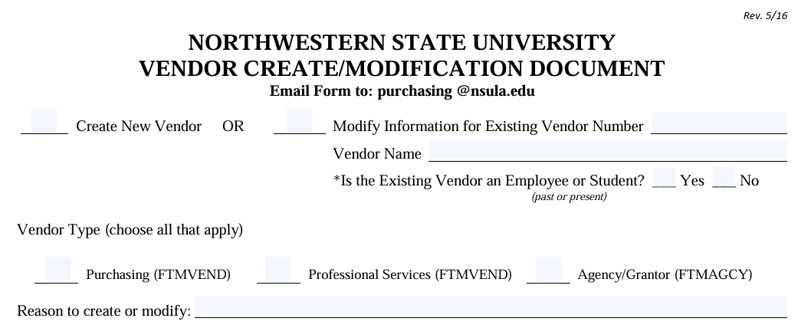
Vendor Create/Modification Form
Top Section of Form.
If modifying existing vendor, be sure to include vendor # and vendor name.
Select New Vendor or Modify Existing Vendor
Purchasing cannot make changes to current employee or current student names or addresses.
Select Vendor Type
Must state the reason for creating or modifying vendor.

Slide 20
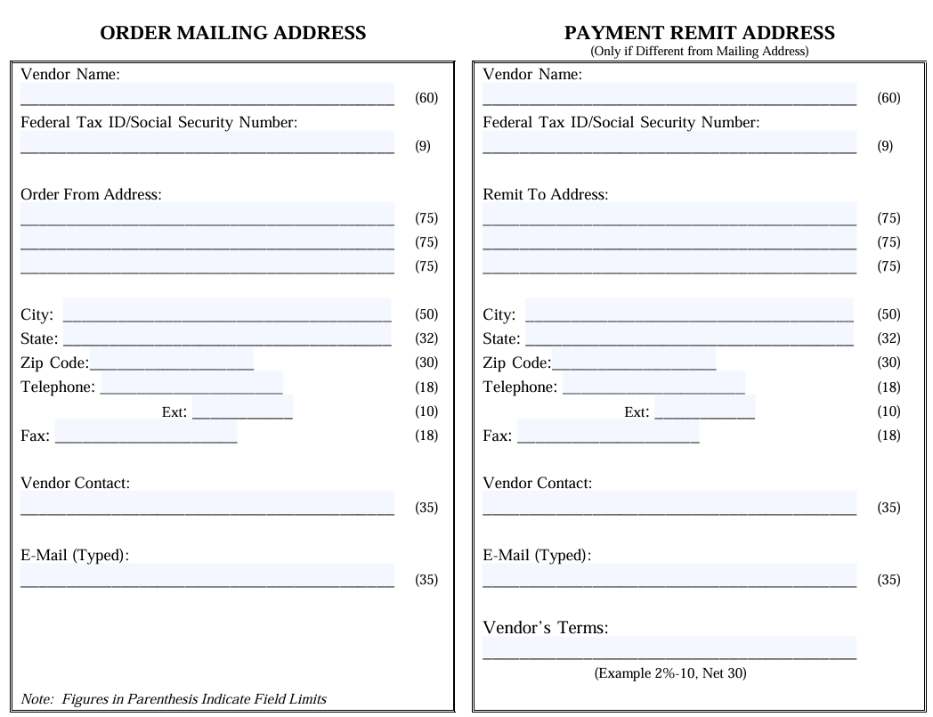
Vendor Create/Modification Form
Middle Section of Form.
Order Mailing Address:
Complete each field that the vendor would like to have PO/1099 information mailed to.
Payment Remit Address:
Complete each field that the vendor would like to have checks mailed to.
Must have an email on file for vendor.

Slide 21
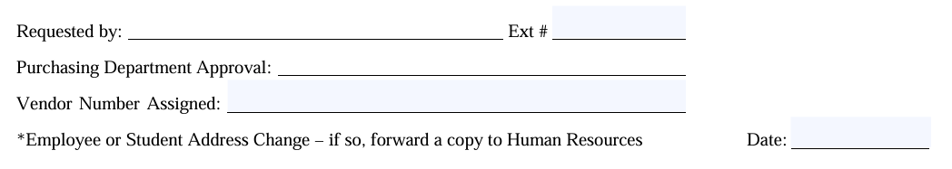
Vendor Create/Modification Form
Bottom Section of Form.
Requestor Signature & Extension #
Once created/updated, Purchasing will sign and state banner vendor #.
If change is for an employee, please contact HR.
If change is for a student, please contact the Registrar’s Office.

Slide 22
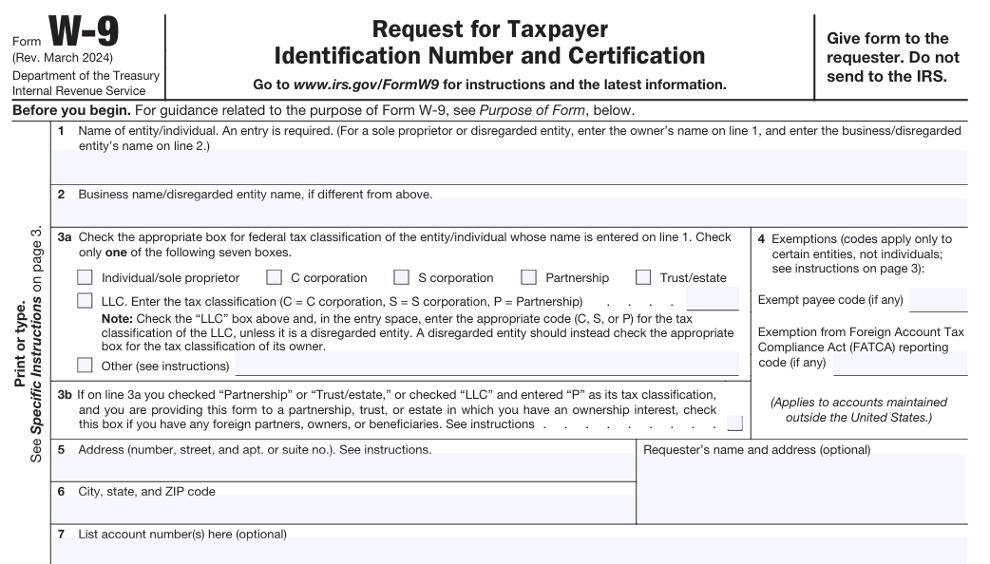
W-9 Form
Top Section of Form.
When obtaining a W-9 be sure it is the most current up-to-date version per IRS.
Name must be clear and legible.
If vendor has a DBA, name must be clear and legible.
Vendor must select the appropriate box for Section 3a.
Information is important for tax purposes.
Vendor must complete:
Address
City, State, and Zip Code

Slide 23
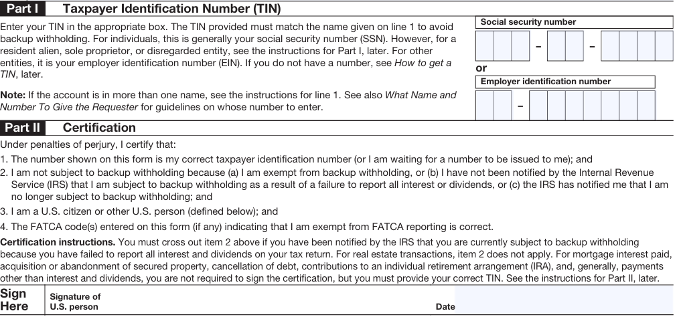
W-9 Form
Middle Section of Form.
TIN must only be SSN or EIN, not both. Again, must be clear and legible.
Vendor must sign & date.

Slide 24
Questions?

