Slide 1

Purchasing 101

Slide 2
AGENDA
Introduction
Forms
Small Purchases
Processes
Questions

Slide 3
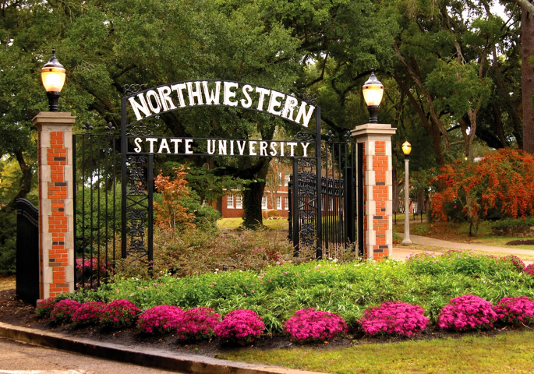
Areas We Serve
All NSU Departments across the following campuses and locations:
  Natchitoches
  CENLA
  Fort Polk
  Shreveport
  Marksville

Slide 4
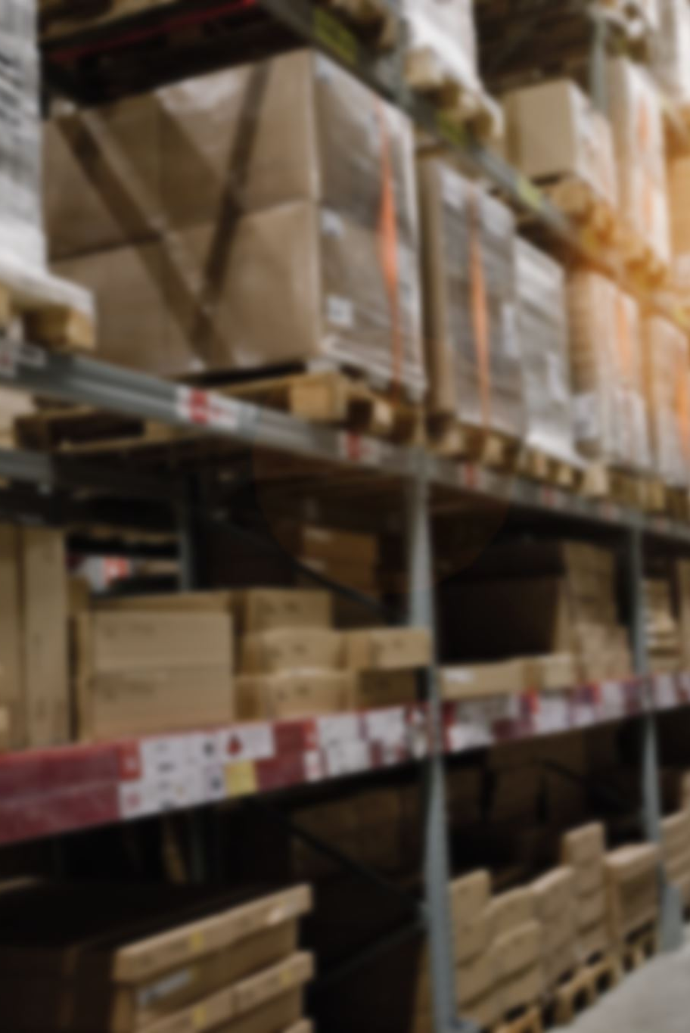
Purchasing responsibilities
Secure goods and services at the best value through a fair and competitive process.
Support timely delivery of departmental purchases
Help resolve shipment discrepancies.
Consolidate purchases to maximize volume discounts.
Promote proper use of the University Warehouse.

Slide 5
Purchasing does not handle
Invoices: Accounts Payable
Budget Revisions & Grants: Accounting & reporting
Finance Access & Approver Updates: Data Entry
Extra Service & Non-Credit Presenter Contracts: Human Resources
Employee Address Updates: Human Resources

Slide 6
Prohibited Expenditures
University funds generally cannot be used for:
Alcohol or sales tax
Prepayments or deposits without prior approval
Employee meals or office celebrations
Meals for guests or employees’ family members
Food or catering from University employees
Routine meeting or retreat meals
Hospitality supplies: coffee makers, coffee, soft drinks, snacks, and bottled water
Certain meal purchases may be allowed with advance approval under University policy.

Slide 7

Which Payment Form Should I Use?

Slide 8
Direct pay vs. account payable voucher
Direct Pay | Accounts Payable Voucher (APV)
Used for allowable purchases under $500 when the item has already been picked up and invoiced | Used to request payment for an invoice connected to an existing Purchase Order
Does not require a requisition, Purchase Order, or receiving | Purchase Order and receiving requirements must already be completed
Requires Prepared By, Budget Unit Head, and VP/President approval | Requires Prepared By and Budget Unit Head approval
Verify sufficient funds before submitting | Include the Purchase Order number and supporting invoice
Submit to nsuacctspay@nsula.edu | Submit to nsuacctspay@nsula.edu
Quick Reminder:
No PO and under $500? Use a Direct Pay.
Invoice tied to an existing PO? Use an APV.

Slide 9
JML 25-104 small purchases
Confirming Order <$5,000
Orders Not Exceeding $30,000
Telephone Quotes $30,000 < $60,000
Non-Competitive
State Contract
Sealed Bids > $60,000

Slide 10
Confirming orders: When is it used?
For purchases under $5,000
When goods or services were ordered or received before a Purchase Order was issued
Should be used only when necessary—not as the normal purchasing process
PO Type: CO

Slide 11
Required process for confirming orders
Enter a requisition in Banner.
Include the vendor’s name, invoice or receipt number, and a clear explanation in Document Text.
Email the invoice or receipt to purchasing@nsula.edu for review.
Send the original invoice or receipt to Accounts Payable.
Purchasing will issue the official Purchase Order.
Complete receiving in Banner once the goods or services have been received.
A Confirming Order documents an after-the-fact purchase.
Departments should obtain proper approval and a Purchase Order before ordering whenever possible.

Slide 12
Orders not exceeding $30,000
When is it used?
For purchases not exceeding $30,000
PO Type: NW
Department must obtain a quote or estimate
Purchasing Authority is assigned to the requesting department for this process

Slide 13
Required Process for NW’s
Obtain a quote or estimate from the vendor.
Enter a requisition in Banner and include the quote number or estimate in Document Text.
Email the quote and supporting documentation to purchasing@nsula.edu.
Purchasing will review the documentation and issue the official Purchase Order.
Send the original invoice or receipt to Accounts Payable.
Complete receiving in Banner once the goods or services are delivered.
Important: Do not place the order until the official Purchase Order has been issued.

Slide 14
Telephone Quotes when is it used?
For purchases from $30,000 to $60,000
PO Type: TQ
Requires quotes from at least three vendors
The requesting department obtains the quotes

Slide 15
Required process for Tq’s
Obtain three written, facsimile, or electronic quotes.
Complete the Telephone Quotation Tabulation Form.
Enter a requisition in Banner and include the quote information in Document Text.
Email the quotes, completed form, and supporting documentation to purchasing@nsula.edu.
Purchasing will review the documentation and issue the official Purchase Order.
Send the original invoice to Accounts Payable and complete receiving in Banner.
Important: Do not place the order until Purchasing issues the official Purchase Order.

Slide 16
Sealed bids when is it used?
For purchases exceeding $60,000
PO Type: SB
Managed by the Purchasing Office
Requires public advertisement and competitive sealed bids

Slide 17
Required process for sb’s
The department develops detailed specifications and submits them to Purchasing.
Purchasing prepares and publicly advertises the solicitation.
Vendors submit sealed bids by the established deadline.
The Budget Unit Head reviews the responses when requested.
Purchasing determines the award and issues the official Purchase Order.
Important: Allow sufficient processing time. Sealed bids generally require a 21-day advertisement period.

Slide 18
State contracts when is it used?
When the needed goods or services are available through an approved Louisiana State Contract
PO Type: SC
Does not require the regular competitive quote process

Slide 19
Required process for SC’s
Locate the appropriate contract and approved vendor in Louisiana eCat.
Obtain a quote that includes the State Contract number and contract pricing.
Enter a requisition in Banner.
Attach or email the quote and supporting documentation to Purchasing.
Purchasing verifies the contract and issues the official Purchase Order.
Important: The item, vendor, and price must match the approved State Contract.

Slide 20
Professional Services:
When is a contract required?
A Professional Service Contract is required when hiring an individual or company to provide specialized services, including:
Professional, personal, consulting, or social services
Presenters, speakers, performers, or consultants
Training, evaluations, technical services, or other specialized work
Important: Employees may not authorize services, sign agreements, or allow work to begin before the contract is fully approved.

Slide 21
Required process for PS’s
Contact Purchasing before making a commitment to the contractor.
Complete the appropriate contract and supporting forms.
Obtain the required signatures and approvals.
Enter a requisition in Banner.
Submit all documentation to Purchasing for review.
Wait for the fully executed contract and Purchase Order before services begin.

Slide 22
Supporting documentation may include:
Professional Service Contract
Scope of services and payment terms
Resume or qualifications
W-9 and vendor information
Justification or selection documentation
Required approval forms

Slide 23
Approval requirements for PS’s
Contract Amount | Required Approval
Up to $19,999 | University Review and Approval
$20,000 or more | Civil Service Approval
$40,000 or more | JLCB Review
Up to $49,999 | Within NSU’s Delegated Authority
Over $49,999 | President’s signature required
Important: Approval requirements are based on the total compensation for the entire contract term—not individual payments or invoices.

Slide 24
Overview: before you make a purchase
Check your budget and confirm funds are available.
Determine the correct purchasing method based on the total purchase amount.
Obtain all required quotes, forms, and approvals.
Enter the requisition and submit supporting documentation.
Wait for the official Purchase Order before placing the order.
Complete receiving after the goods or services are delivered.
When in doubt, contact Purchasing before making a commitment to a vendor.

Slide 25
Purchasing Department
Ashlee Grayson Akilah Farris
Director of Purchasing Purchasing Agent
318-357-6474 318-357-5641
graysona@nsula.edu farrisa@nsula.edu
LaShonda Burton
Purchasing Administrative Coordinator
318-357-5139
burtonl@nsula.edu

